Slide 1
S1. Economics of Environment : the Age of Constraints
Malthus&Co
Xavier Timbeau
xavier.timbeau@sciencespo.fr
Anissa Saumtally
anissa.saumtally@sciencespo.fr

Slide 2
How scarce ressources limit population and income
But also influence inequalities
How the Malthusian trap was escaped

Slide 3
Limits to growth : an old intuition
Malthus (food production), Ricardo (decreasing return to agriculture)
Jevons (depletion of coal, the fuel for industrial revolution, 1865)
Mr&Mrs Meadows (natural resources depletion)
  Club of Rome,1968 report from MIT researcher (futurologists)
  The Limits to Growth carries a wide review of natural resources, assess reserves and explore 5 exponential trends demographic, means of subsistence production, industrialization, pollution, consumption of exhaustible resources (oil, but many others)
  2004 : Limits to Growth : The 30 Year Update
Each time, technology, price&behaviour response have pushed back the limits. Far away.
But we need to go further this simple scheme
  Unified growth (Galor, Kremer)
  Pomeranz, Barbier and Californian Economic History School

Slide 4
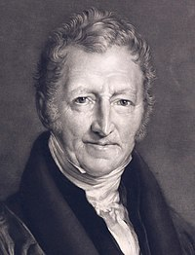
Malthusian trap (aka unified growth)
Imagine that you need a minimum income (consumption) to live
  Absolute poverty (2$/day), what is needed to sustain your productive capacity
  Let’s call it starvation income (SI)
  Population dynamics (evolution over time) will depend on current income relative to SI
    Human ecology, population dynamics similar to other living being
    First hypothesized by Malthus, (inspired Darwin, Spencer and others)
    A major breakthrough: humans are not god creature
    One of the first general equilibrium analysis
    Malthus concludes that to fight poverty, you need to stop charity and reduce birth when poors (poors have to marry before sex)
    Malthus is the first neo conservative: science and reason at the service of religious morality and commands. Reconciliation between old and enlightment morals
Technically, population is endogenous in a growth model
Main references:
  Lucas, R.E Jr, 1999, “The industrial revolution: past and future”, Mimeo, Department of economics, University of Chicago
  Galor O. and Weil D.N., 2000. "Population , Technology , and Growth : From Malthusian Stagnation to the Demographic Transition and beyond", The American Economic Review, 90(4), 806–828.
  Galor O., 2010. "The 2008 Lawrence R. Klein lecture - comparative economic development: Insights from unified growth theory", International Economic Review, 51(1), 1–44.
Thomas Robert Malthus
1766-1834

Slide 5
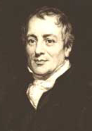
The Malthusian trap: compoments
Population dynamics
  Current Income>SI then population increases (less mortality, more fertility)
  Reverse if SI>CI
  Special case : control of population
Decreasing returns in production of land and fixed quantity of land
  Land is a non accumulated factor
  Land productivity is decreasing
    More labor implied more output
    More input yields proportionally less output (decreasing returns)
    Also named decreasing marginal productivity
    Because of decreasing returns, population is limited
      At some point, when adding a worker, output is going to increase by less than what is needed to feed the additional worker
  Exogenous shocks can increase output
    More lands discovered, new techniques (seeds, irrigation, rotation of culture, fertilizers, mechanization) can increase the output per unit of surface (and unit of work)
    Questions: what is going to happen to
    output? population? output per person?
    mean and median output per person?
    Inequalities?
David Ricardo 1772-1823

Slide 6










Graphical Malthusian trap
Suppose production function is the usual Cobb Douglas:
$$f\left(K,L\right)=A K^{α}L^{1−α}, 1>α>0$$
$K$ stands for capital, i.e. land and is fixed
$L$ stands for labor, unit is person, for sake of simplicity, $L$ is supposed equal to population (no inactive).
$S$ is surplus ($S=f−wL)$
$$\frac{f}{pop}=\frac{f}{L}=\frac{AK^{α}}{L^{α}}$$
is a decreasing function of $L$
In a competitive labor market
$$w=f_{L}^{′}=\left(1−α\right)\frac{f}{L}<\frac{f}{L}$$
Equilibrium population in competitive market
$$L^{∗}={\left(\frac{\left(1−α\right)A}{\hat{w}}\right)}^{\frac{1}{α}}K$$
Full share equilibrium
$L^{∗∗}={\left(\frac{A}{\hat{w}}\right)}^{\frac{1}{α}}K=\frac{L^{∗}}{{\left(1−α\right)}^{\frac{1}{α}}}>L^{∗}$
When $f_{L}^{′}=\hat{w}$, then $S=\frac{α}{1−α}\hat{w}L^{∗}>0$
The higher the $α$, the higher the surplus
$$\hat{w}.pop line quantity of food necessary to feed everyone$$
$$\hat{w} is stavation income$$
production
production $f(pop)$
$$f’>0, f^{′′}<0$$
$$S$$
$$f^{′}\left(pop\right)=\hat{w}$$
No surplus full (equal) share of production $f=\hat{w}L$
population
Production/population
$$\frac{S}{L}$$
$$f(pop)/pop$$
$$\hat{w}=f(pop)/pop$$
$$w=f’(pop)$$
$$f^{′}\left(pop\right)=\hat{w}$$
No surplus full (equal) share of production $f=\hat{w}L$
population

Slide 7















Graphical Malthusian trap
Increases in $K$ (new land) or in $A$ (technical progress) will shift the production function upward
Population is going to increase
$$L^{∗}={\left(\frac{\left(1−α\right)A}{\hat{w}}\right)}^{\frac{1}{α}}K$$
And surplus is going to increase
$$S=\frac{α}{1−α}\hat{w}L^{∗}=α{\left(\frac{1−α}{\hat{w}}\right)}^{\frac{1−α}{α}}A^{\frac{1}{α}}K$$
But, by design, $\hat{w}$ is the same
production
$$\hat{w}.pop line$$
production $f(pop)$
$$f’>0, f^{′′}<0$$
$$S′$$
$$S$$
$$L^{∗}$$
$L^{∗}$’
$$L^{∗∗}$$
No surplus $f=\hat{w}L$
$$L^{∗∗}′$$
population
Production/population
$$\frac{S}{L}$$
$$f(pop)/pop$$
$$\hat{w}=f(pop)/pop$$
$$w=f’(pop)$$
$$L^{∗}$$
$L^{∗}$’
$$L^{∗∗}$$
population

Slide 8



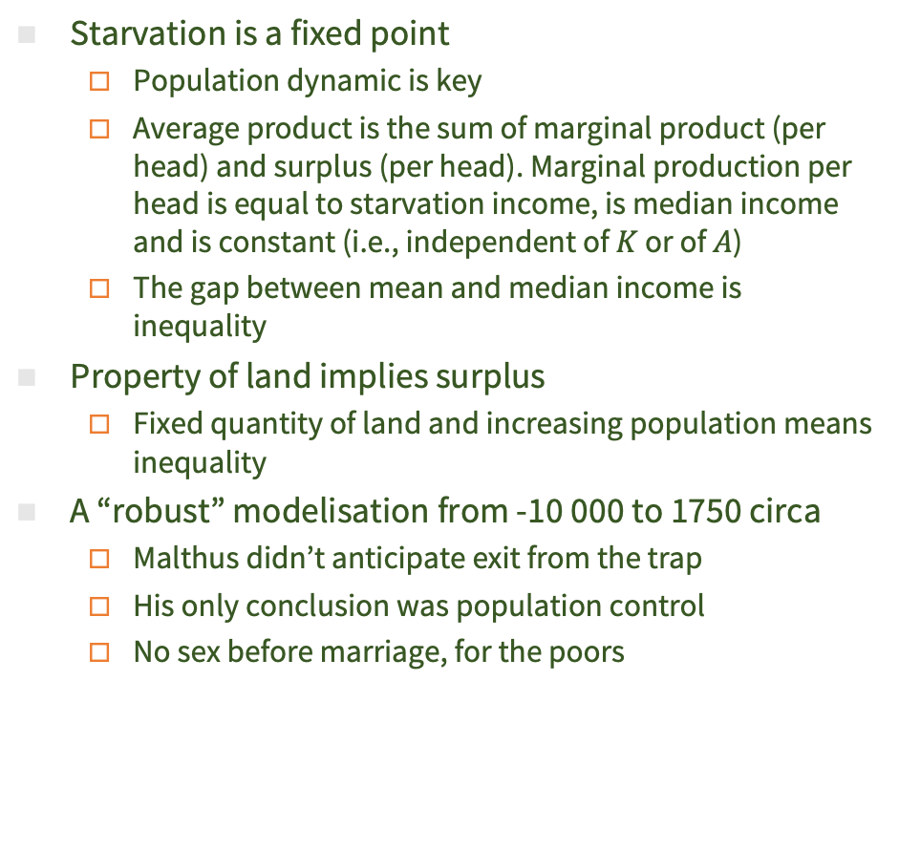



Malthusian trap: consequences
Starvation is a fixed point
  Population dynamic is key
  Average product is the sum of marginal product (per head) and surplus (per head). Marginal production per head is equal to starvation income, is median income and is constant (i.e., independent of $K$ or of $A$)
  The gap between mean and median income is inequality
Property of land implies surplus
  Fixed quantity of land and increasing population means inequality
A “robust” modelisation from -10 000 to 1750 circa
  Malthus didn’t anticipate exit from the trap
  His only conclusion was population control
  No sex before marriage, for the poors
Food/pop=starvation level
Food output
$$L^{∗}$$
$L^{∗}$’
$$L^{∗∗}$$
$L^{∗∗}$’
$$L^{c}$$
Comp. LM
$w^{c}>w^{∗}$
$$L^{c}$$
full share
population

Slide 9
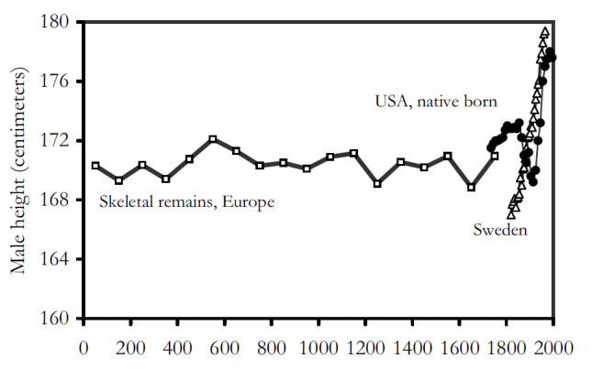
Some facts
Source: Clark, G., Rogers, J. E. T., Beveridge, W., Gilboy, E., & Phelps-brown, H. (1850). THE LONG MARCH OF HISTORY : FARM LABORERS ’ WAGES IN ENGLAND 1208-1850, 1–35.
Wages are built using various sources, based on archive data, manuscript wages statement, and so on. Cost of living is based on price information about grains.

Slide 10



Are you malthusian ?

Slide 11
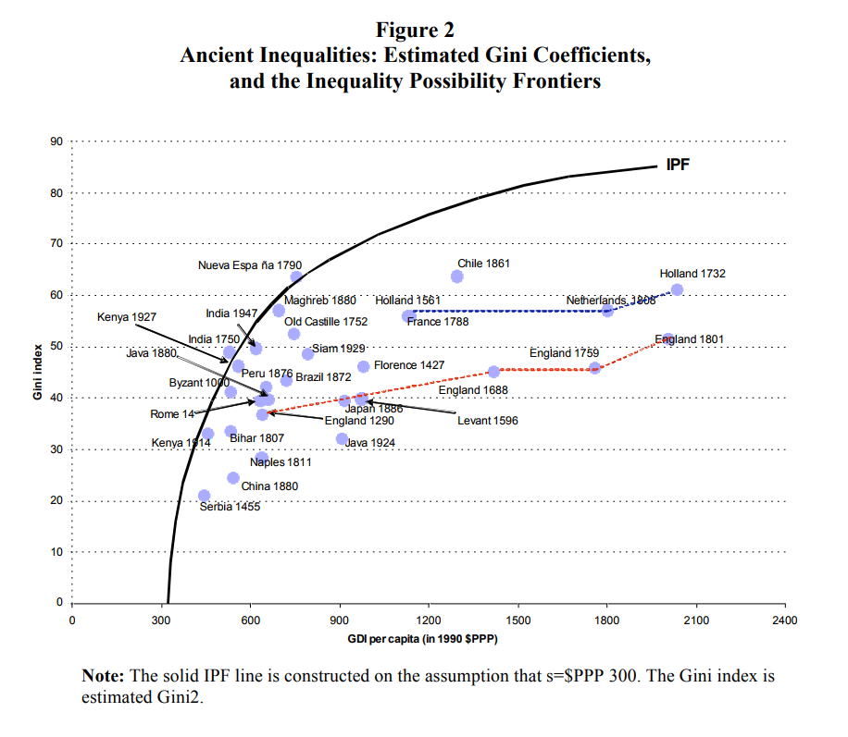

Inequality and level of development
IPF (Inequality Possibility frontier) is built as
Everyone has $\hat{w}$ except one who has everything else ($f−\hat{w}L)$
Gini is
0 for equal repartition
1 for 0 to everyone and all for one
IPF for everyone $\hat{w}$, the rest to one (maximum inequality possible)
When total production increases, IPF increases
Milanovic Branko, Peter H. Lindert et Jeffrey G. Williamson, « Pre-Industrial Inequality », Economic Journal, vol. 121, p. 255‑272, 2010.

Slide 12
Inequality and level of development
Milanovic Branko, Peter H. Lindert et Jeffrey G. Williamson, « Pre-Industrial Inequality », Economic Journal, vol. 121, p. 255‑272, 2010.

Slide 13
Inequality and level of development
Milanovic Branko, Peter H. Lindert et Jeffrey G. Williamson, « Pre-Industrial Inequality », Economic Journal, vol. 121, p. 255‑272, 2010.

Slide 14
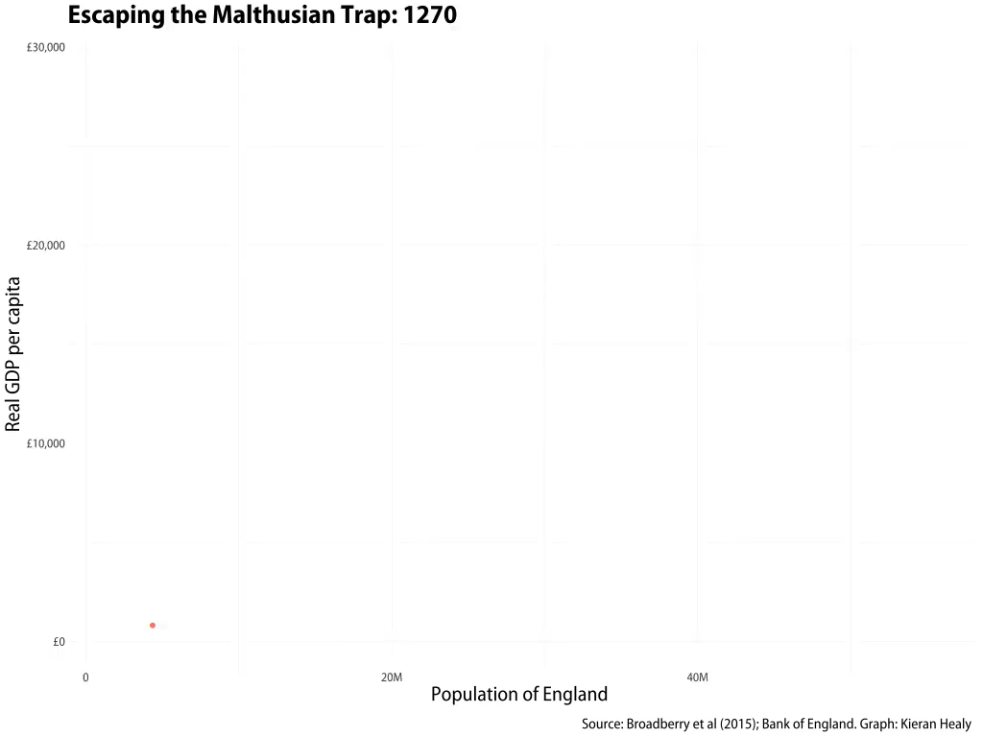
Another compelling visualisation
kjhealy/england_gdp_long (github.com)

Slide 15









How to escape from Malthusian trap ?
Have a ‘production shift’ faster than population increase
  If capital accumulation is possible, then faster
  If rate of growth of tech. shift is lower than population, then population increase absorb all technological progress
  If rate of growth is faster, then median food/pop can rise
    If median/pop rises, than starvation is no more a ‘point fixe’, widespread accumulation is made possible
    wealth is accumulated and will be transmitted to descendants; but split of legacy leads to less child/person->demographic transition, decrease in the rate of growth of population
    Equaly, accumulation bring capital, which needs know how, which needs education: children are a cost and a future yield (investment). Less children may bring better future
  Cumulative (positive feedback loop) process make the escape from the Malthusian trap faster and faster
Then come innovations, fueled by new markets and demand for new goods
  Mechanization and chemistry of agriculture was an important leap
  Increase in productivity of agriculture made possible the advent of industry
    Population shifting from agricultural sector to industrial sector
    Causality may be the reverse (urbanization needs agriculture progress, urbanization produces innovation and incentives to get out ‘agricultural’ trap and gives a use for the surplus)
production
$$w^{∗′′}=\hat{w}$$
$$\hat{w}.pop line$$
$$w^{′}>\hat{w}$$
$$w^{∗′}=\hat{w}$$
production $f(pop)$
$$f’>0, f^{′′}<0$$
$$w^{∗}=\hat{w}$$
$$L^{∗}$$
$$L^{∗}′$$
$$L^{∗′′}$$
population

Slide 16


A reading suggestion: Quinn, Cain kills Abel

Slide 17
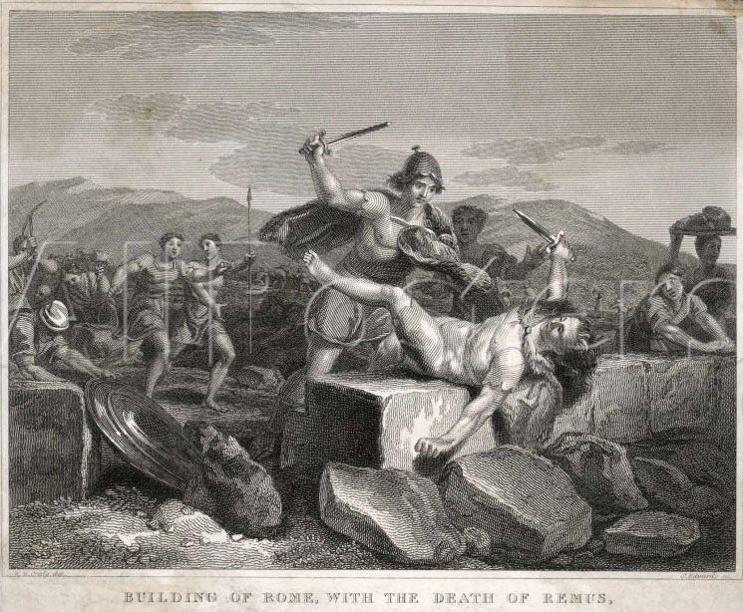
The death of Remus: the end of pastoralism

Slide 18
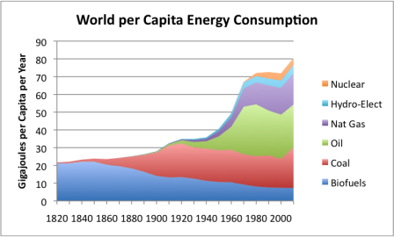
Energy and the industrial revolution
  The common view is that industrial revolution started at the end of the XVIIIth century
    In England first (1750-); then in continental Europe
    But not in Asia, India, or Africa despite technological advances, advanced urbanization, or access to natural resources
  Before industrial revolution: agricultural revolution
    A prerequisite for industrial growth ? How to feed people ?
  Industrial revolution could be seen as the shift from “organic” economy to fossil economy
    Energy production does not rely anymore on human, animal or wood combustion power (also hydraulic or wind energy)
    But is based on fossil fuel, huge increase in energy productivity and consumption (energetic slaves)
    Use of energy induces increase in productivity
  A different (more recent) view is that
    Industrial revolution happened on small pockets, anywhere in Europe
      but more of those in England (why more there ?)
      An answer: availability of surface coal, inexpensive to extract, plus increasing returns to extraction with steam (coal) power
  The decrease in cost of energy has been huge (more than a thousand time)
    1500W for 6min (a hairdryer) asks for 1500/10=150Wh=0.15kWh cost today 0.15kWh, a kWH consumer final cost is .15€ in France (green energy by the way), so around 2.25c€ (=0.15*0.15)
    Human power generation would ask 5-10 humans (FTP around 200W, 400W for a champion) pedaling for 6m, 30-60 minutes of labor. Cost of labor (15€/h) would make the cost 7.5-15€. Capital cost, transportation of energy (or persons) would increase that even more.
Per capita energy consumption, Europe
Share of coal consumtion in Europe

Slide 19
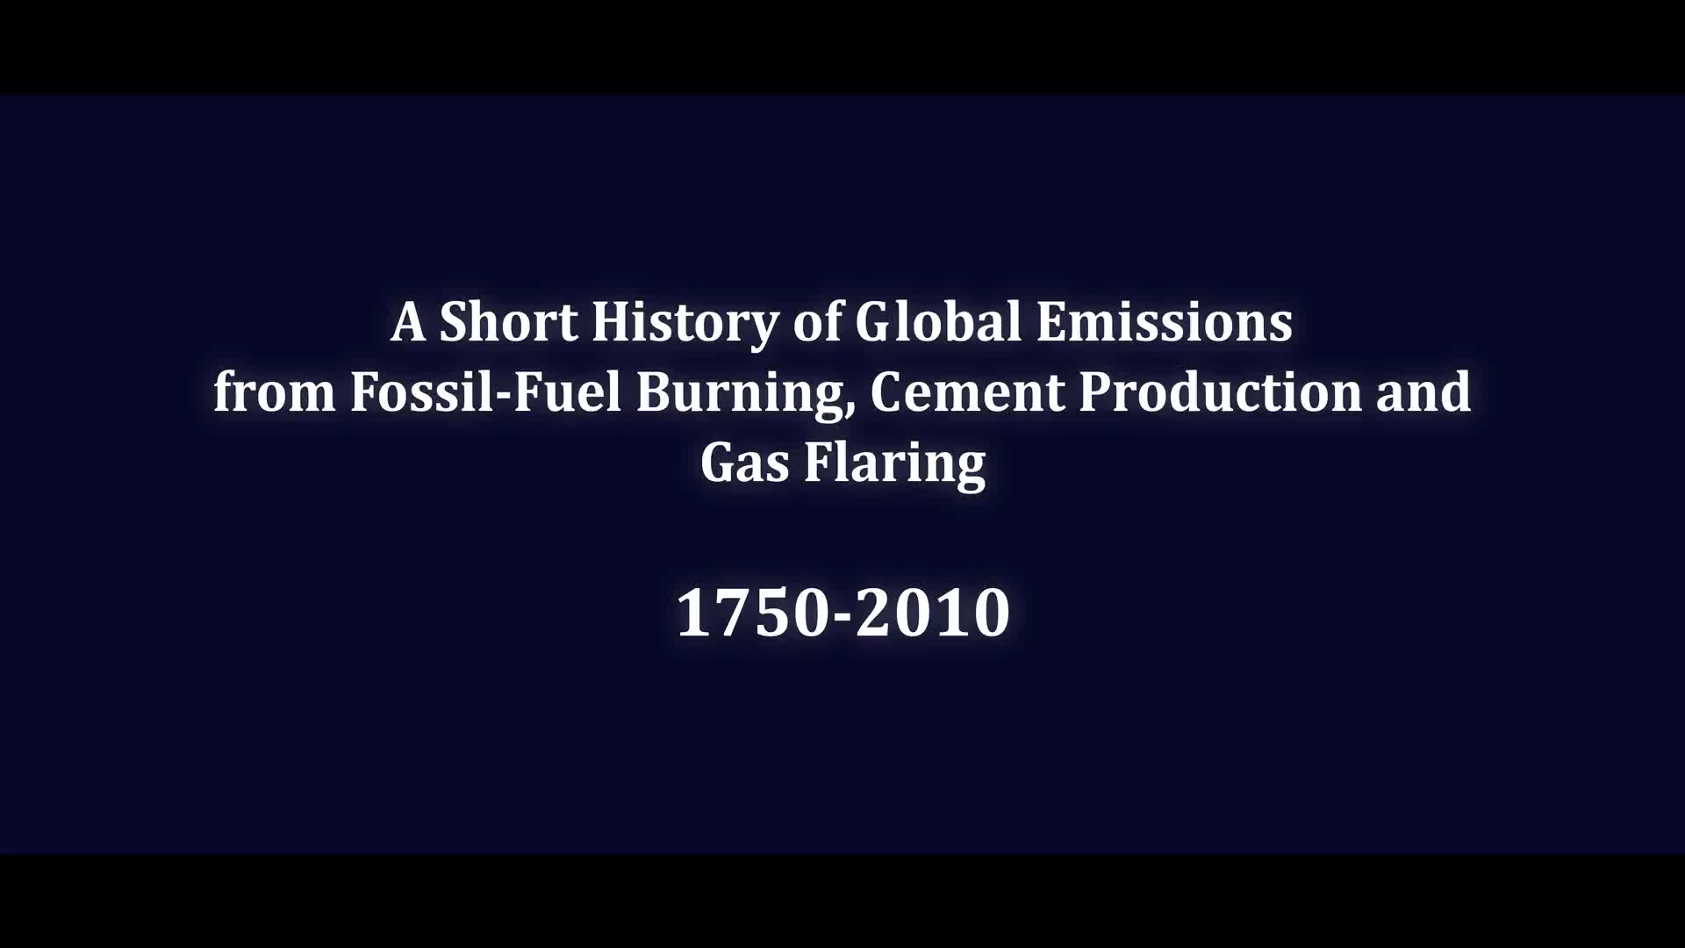
A movie of Industrial revolution
http://aureliensaussay.github.io/historicalemissions/interactive.html#

